Slide 1

Báo Cáo Đồ Án
Hướng dẫn: TS. Võ Văn Hải
Thực hiện: Nguyễn Văn Sơn
Trần Thiện Đạt
Tô Hiếu Đông

Slide 2
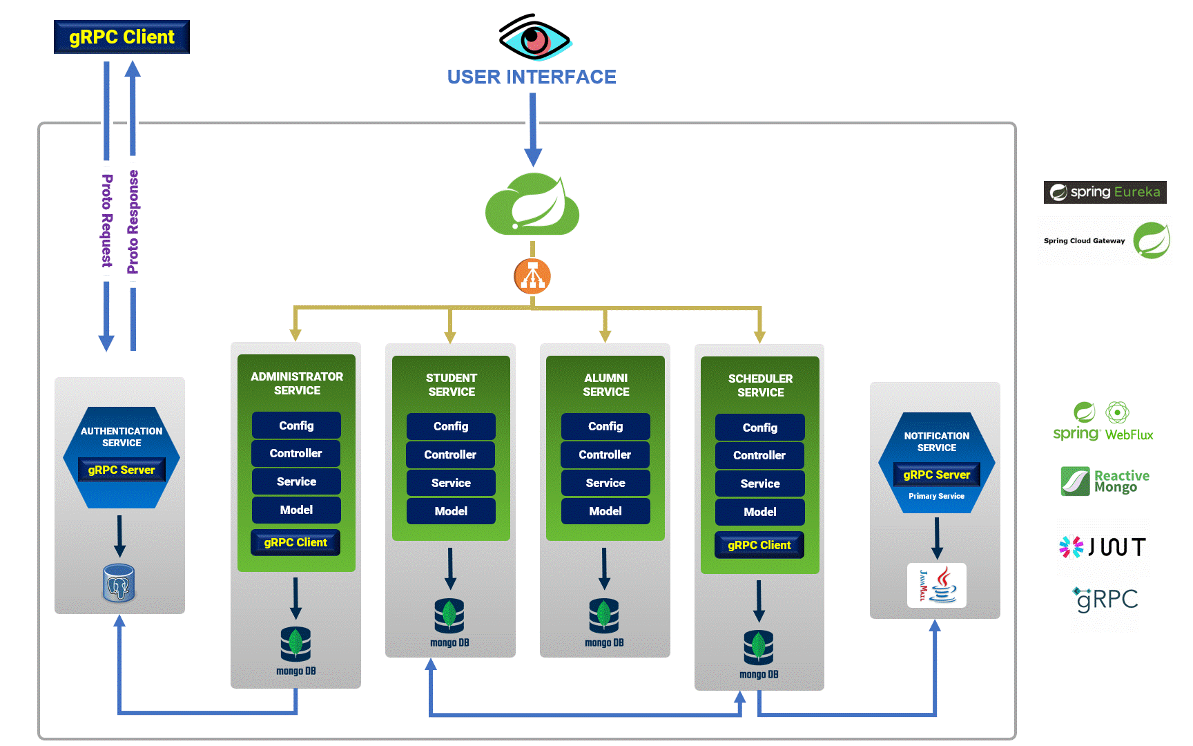
Architecture diagram
1
2
3
4
5
6
7
8

Slide 3
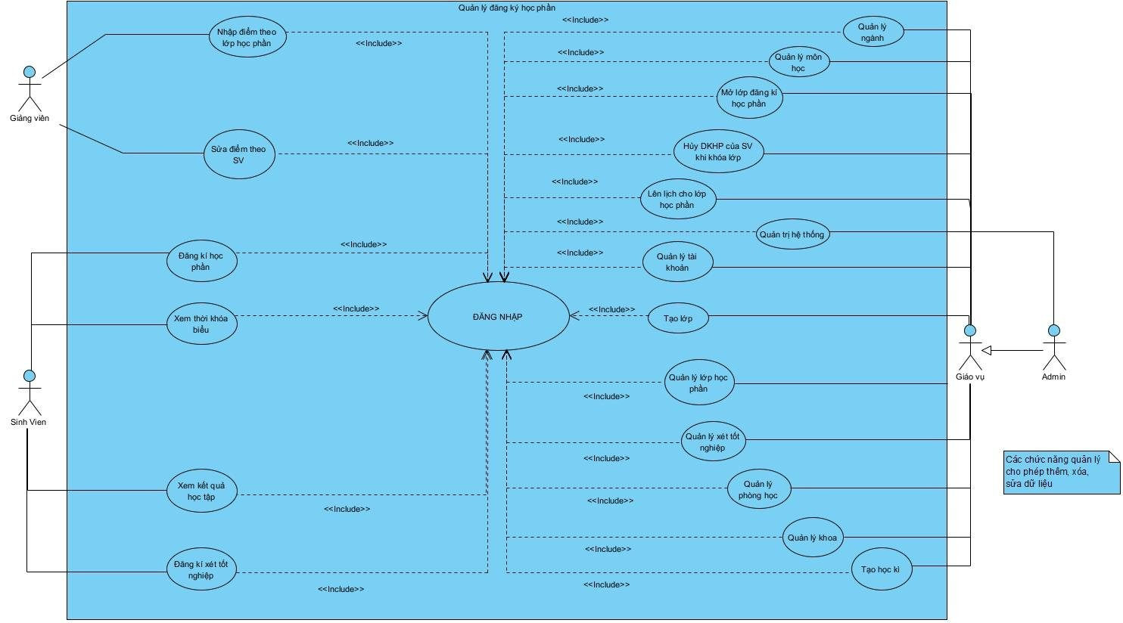
User case diagram
1
2
3
4
5
6
7
8

Slide 4
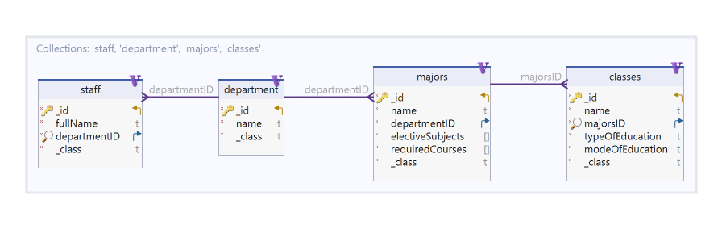
Class diagram
AdministratorService
1
2
3
4
5
6
7
8

Slide 5
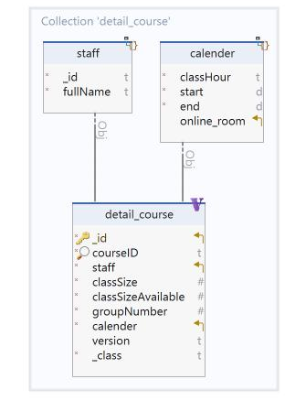
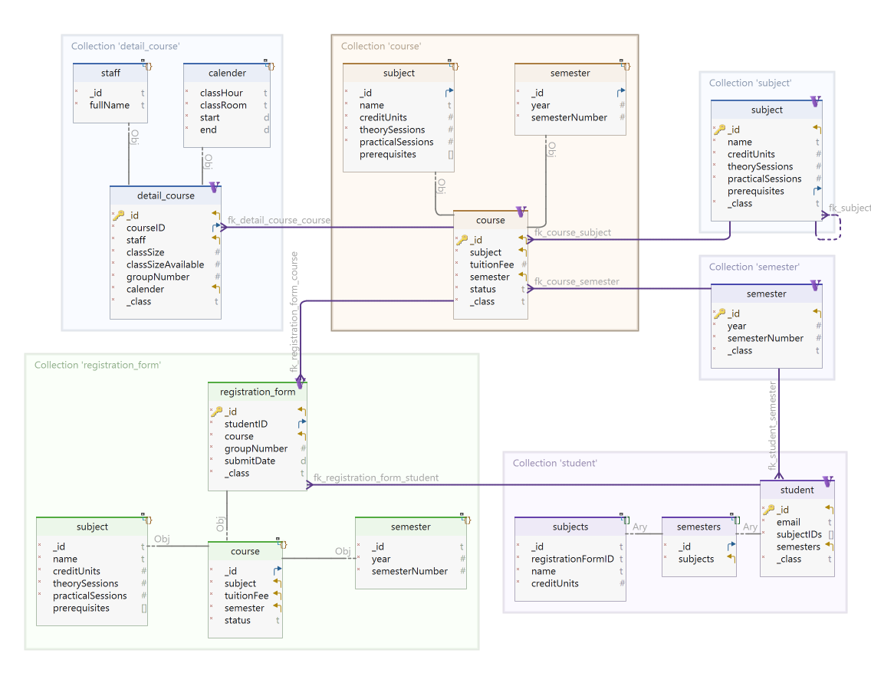
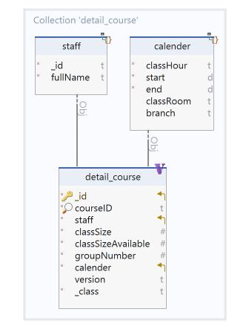
Version 1
Class diagram
SchedulerService
Version 2
1
2
3
4
5
6
7
8

Slide 6
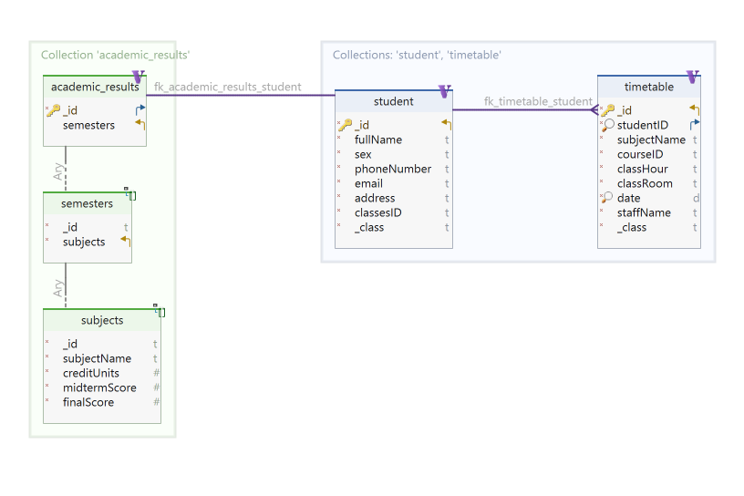
Class diagram
StudentService
1
2
3
4
5
6
7
8

Slide 7
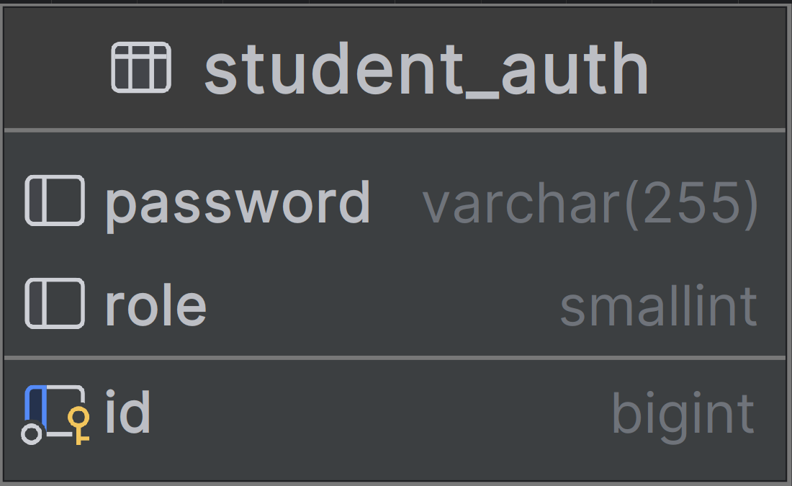
Class diagram
AuthenticationService
1
2
3
4
5
6
7
8

Slide 8
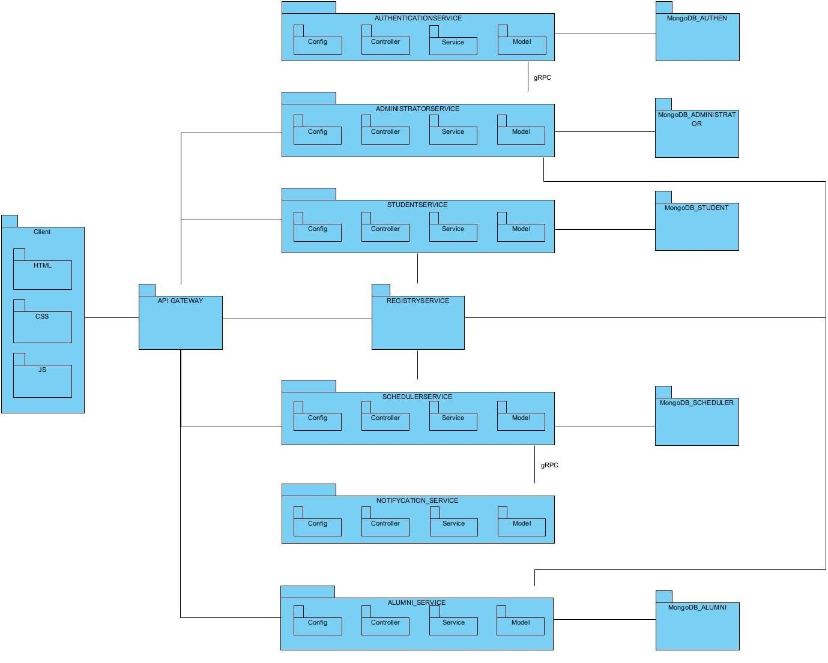
Package diagram
1
2
3
4
5
6
7
8

Slide 9
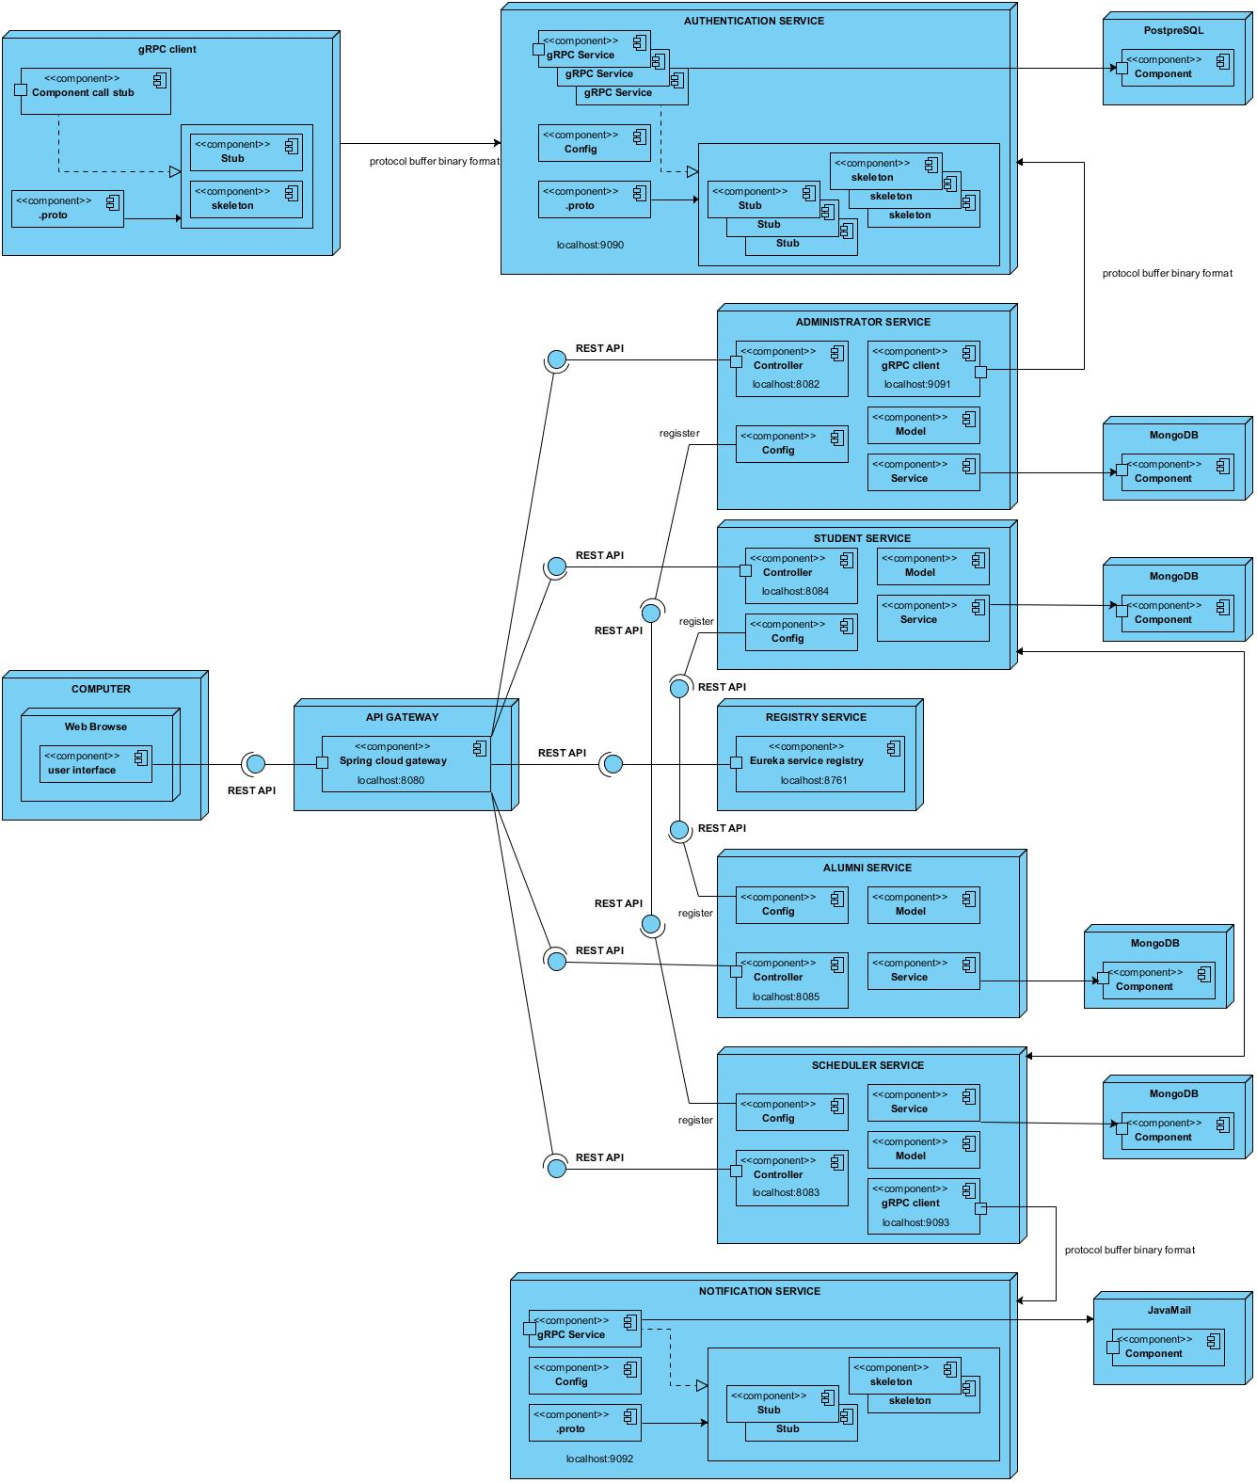
Deployment diagram
1
2
3
4
5
6
7
8

